Slide 1
Pathological Myopia Detection Using Fundus Images
Group members: Supervisor:
Noormah Omar Khan P16-6040 Dr. Hafeez ur Rehman
SABAHAT IJAZ P16-6055
LAIBA GUL P16-6117

Slide 2
List of Content
1- Introduction
2- Why Automatic Detection?
3- Literature Review
4- Problem Statement
5- System Work Flow
6- Classification

Slide 3
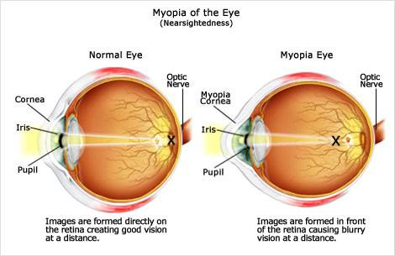
1- Introduction
Myopia is the inability to see things clearly (nearsightedness)[1].
[6]

Slide 4
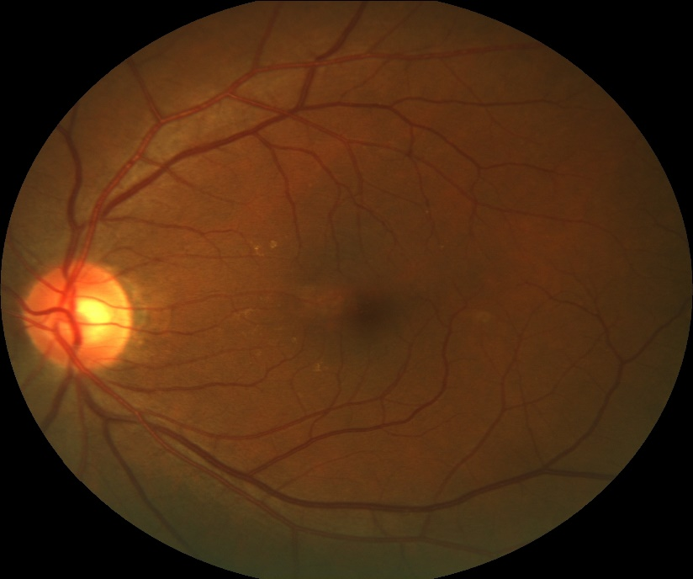
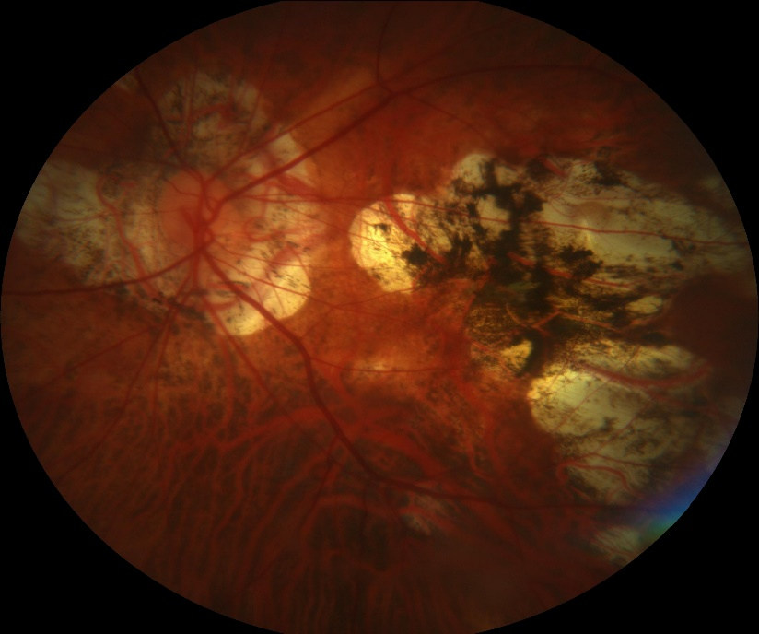
Fundus Image
Normal
Pathologically Myopic

Slide 5
2- Why automatic detection?
Current methods of detection remain:
  Highly reliant on visual acuity testing
  Time-consuming
  Subject to individual patient's evaluation, may be inconsistent

Slide 6
3- Literature Review
Research paper | Conclusion | Gap | Reference
Automatic Detection of Pathological Myopia using Variational Level Set | 95% accuracy. | Detected only using Peripapillary Atrophy. Failure when optic disc is not contained within the center of Region of Interest (ROI). Tested on a very small Dataset | Tan, N. M., Liu, J., Wong, D. W. K., Lim, J. H., Zhang, Z., Lu, S., ... & Wong, T. Y. (2009, September). Automatic detection of pathological myopia using variational level set. In 2009 Annual International Conference of the IEEE Engineering in Medicine and Biology Society (pp. 3609-3612). IEEE.
PAMELA with texture based feature through Support Vector Machine (SVM) approach | 87.5% Accuracy | Detected using only one feature Peripapillary Atrophy (PPA). | Liu, J., Wong, D. W., Lim, J. H., Tan, N. M., Zhang, Z., Li, H., ... & Wong, T. Y. (2010). Detection of pathological myopia by PAMELA with texture-based features through an SVM approach. Journal of Healthcare Engineering, 1(1), 1-11.
Pathological Myopia Detection from selective FUNDUS image features | 85% accuracy | Requires supplementary information other than images to construct features. | Zhang, Z., Cheng, J., Liu, J., Sheri, Y. C. M., Kong, C. C., & Mei, S. S. (2012, July). Pathological myopia detection from selective fundus image features. In 2012 7th IEEE Conference on Industrial Electronics and Applications (ICIEA) (pp. 1742-1745).
Learn To Recognize Pathological Myopia In Fundus Images Using Bag Of Feature and Sparse learning Approach | 90.06% accuracy | Only tested on right eye images | Xu, Y., Liu, J., Zhang, Z., Tan, N. M., Wong, D. W. K., Saw, S. M., & Wong, T. Y. (2013, April). Learn to recognize pathological myopia in fundus images using bag-of-feature and sparse learning approach. In 2013 IEEE 10th International Symposium on Biomedical Imaging (pp. 888-891). IEEE.

Slide 7
4- Problem Statement
Our work detects pathological myopia in fundus images by overcoming the problems caused by the Posterior staphyloma, Lattice degeneration, Fuch’s spots, Tigroid fundus and false detection of the Optic disk.

Slide 8
5- System Work Flow
Fundus Image
Posterior Staphyloma
Region of Interest Extraction
Fuch’s Spots
Feature Extraction
Lattice Degeneration
Classification
Tigroid Fundus
Label
Peripapillary Atrophy

Slide 9
Disease Features
Fuchs Spots
Lattice Degeneration
Posterior Staphyloma
Tigroid Fundus
Peripapillary Atrophy

Slide 10
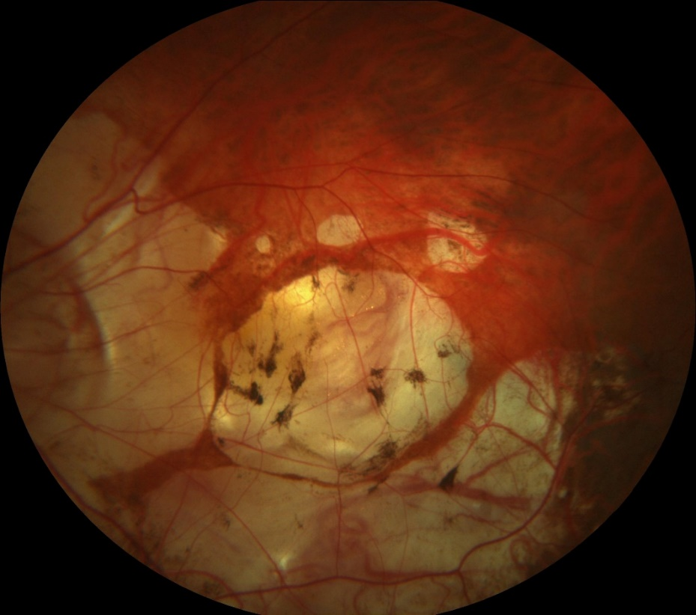
Fuch’s Spots
Also referred to as Forster-Fuchs spots.
Areas of Retinal Pigment Epithelium hyperplasia.

Slide 11
ROI and Feature Extraction for Fuch’s Spots
Region Of Interest Extraction
Feature Extraction
Blob Detection:
Blob detection technique is used to detect the regions in image that differ in color, shape, brightness.
It detects the regions that are different from surrounding.
Fuch’s spots are detected by Simple Blob detection Technique
Oriented and Rotated Brief:
Descriptors for keypoints detected by Blob Detection are computed using Oriented FAST Rotated BRIEF method.
Matrix S contains the pixel values of Keypoints then using the orientation rotated matrix SΘ is computed

Slide 12
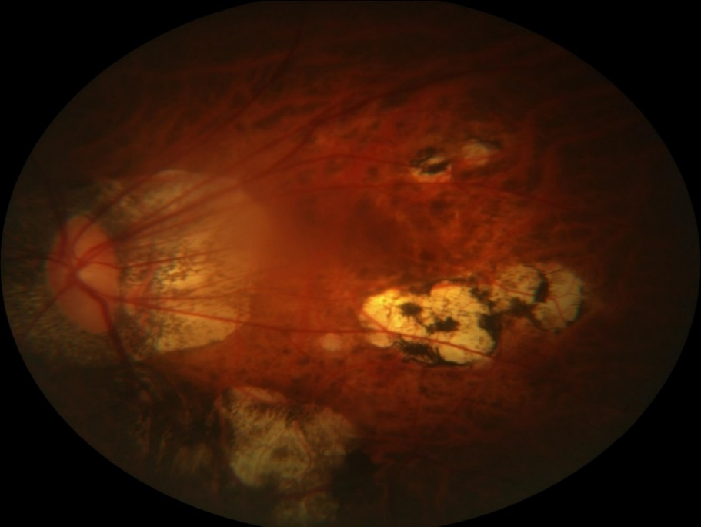
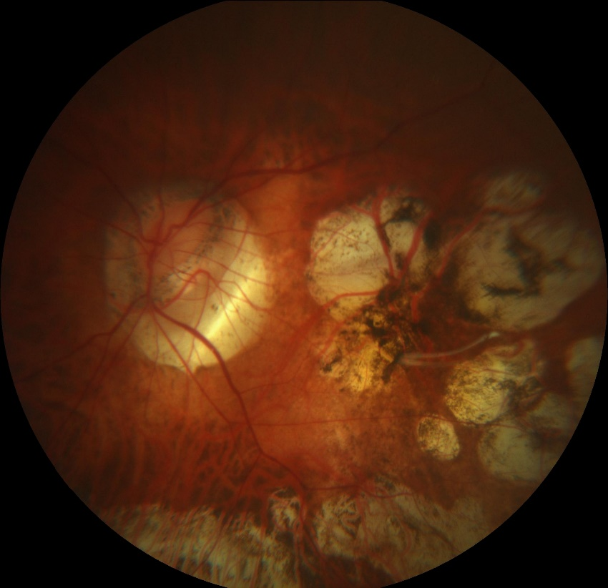
II. Lattice Degeneration and
III. Posterior Staphyloma
Lattice Degeneration
Posterior Staphyloma

Slide 13
ROI Extraction and Features Extraction
Region Of Interest Extraction
Feature Extraction
Contrast Limited Adaptive Histogram Equalization
  Enhances the Image and make Region of Interest mores prominent.
Thresholding Techniques
  Binary threshold
Entropy and Pixel Count

Slide 14
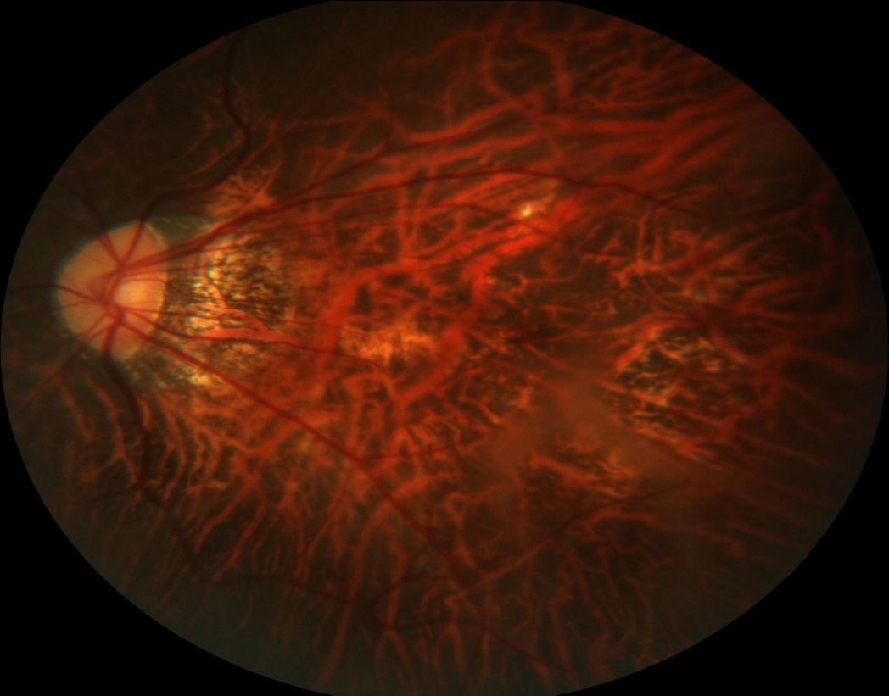
IV. Tigroid Fundus
As the eye enlarges, the retinal pigment epithelium thins, resulting in a tessellated(checkered) appearance of the fundus and increased visibility of the choroidal vasculature.

Slide 15
ROI Extraction and Feature Extraction
Region Of Interest Extraction
Feature Extraction
Thresholding Techniques
  TO_ZERO_INV
Grey Level Co-Occurrence Matrices

Slide 16
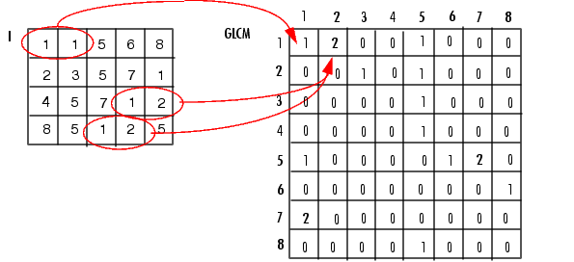
Grey Level Co-occurrence Matrices [5]
Gray Level Co- occurrence Matrix
The intensity of pixels are quantized into specified number of gray levels.
A co-occurrence matrix is computed on gray levels of image.
The count for the gray levels co-occurring at specified angles and at specified distance is stored in matrix.
Then this matrix is used to compute different features.
[7]

Slide 17
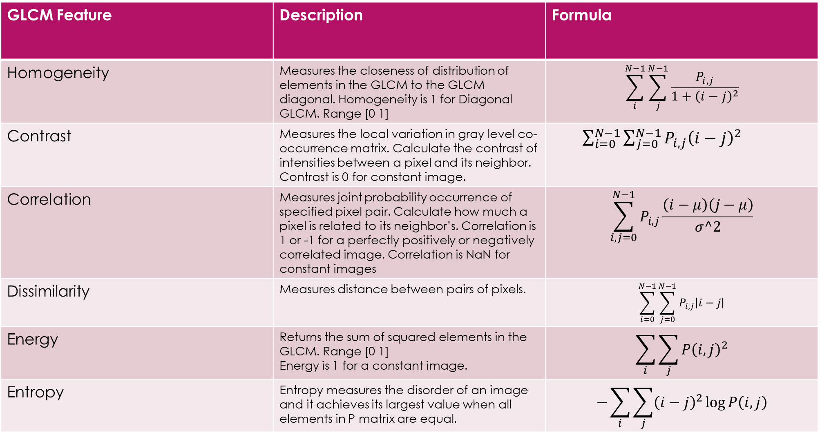
Features Extracted from GLCM

Slide 18
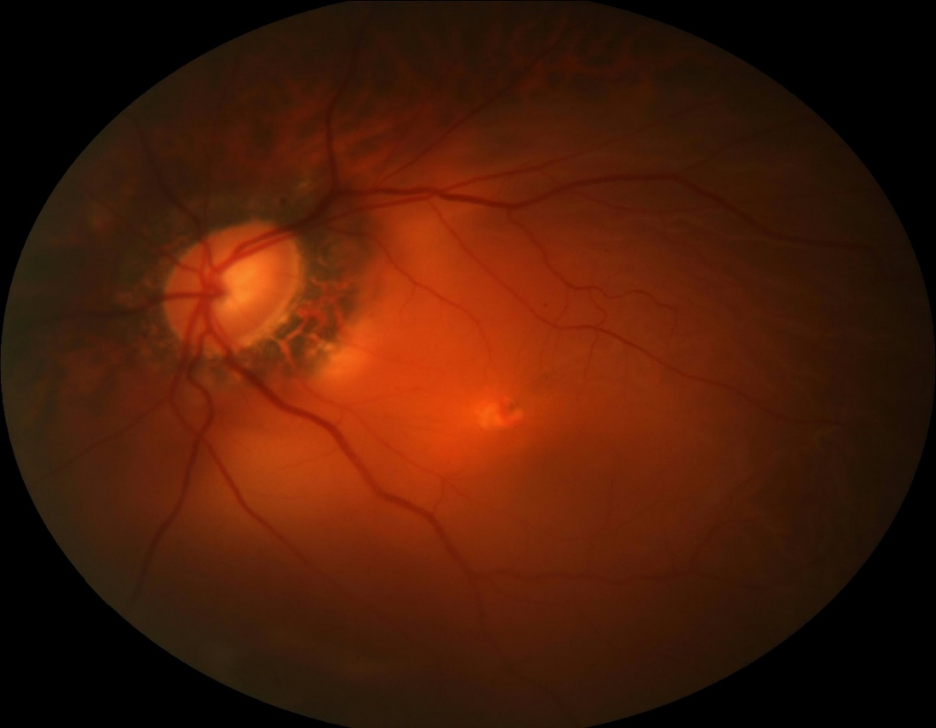
V. Peripapillary Atrophy
Pigmented Crescent-shaped area around Optic Disk
Thinning in the layers of the retina.
Retinal pigment epithelium around the optic nerve[2].

Slide 19
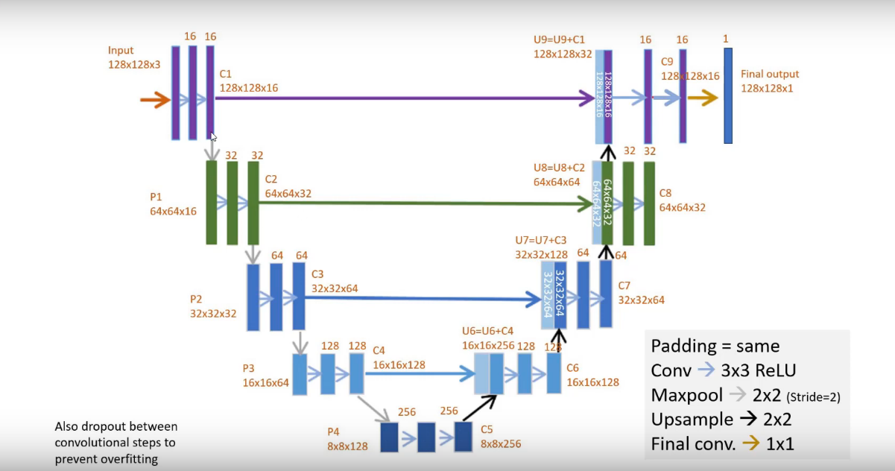
ROI Extraction and Feature Extraction
Region Of Interest Extraction
Feature Extraction
U-Net Model
Entropy and Pixel Count.

Slide 20
6- Classification
Technique Used for Classification
  Support Vector Machine (SVM)
Classes:
  Normal Fundus
  Pathologically Myopic Fundus
  Highly Myopic Fundus

Slide 21
Classification Result
Disease Feature | Accuracy % | Precision % | Recall % | F1-Score % | 10-fold cross validation result %
Fuch’s Spots | 80 | 73.95 | 80 | 76.77 | 79.65
Lattice Degeneration and Posterior Staphyloma | 92.10 | 88.61 | 92.10 | 89.94 | 91.55
Tigroid Fundus | 85 | 80.88 | 85 | 82.87 | 84.23
Peripapillary Atrophy | 91.20 | 85.49 | 91.20 | 88.24 | 92.27

Slide 22
References
[1] Liu, J., Wong, D. W., Lim, J. H., Tan, N. M., Zhang, Z., Li, H., ... & Wong, T. Y. (2010). Detection of pathological myopia by PAMELA with texture-based features through an SVM approach. Journal of Healthcare Engineering, 1(1), 1-11.
[2] Cheng, J., Tao, D., Liu, J., Wong, D. W. K., Tan, N. M., Wong, T. Y., & Saw, S. M. (2012). Peripapillary atrophy detection by sparse biologically inspired feature manifold. IEEE transactions on medical imaging, 31(12), 2355-2365.
[3] Zhang, Z., Cheng, J., Liu, J., Sheri, Y. C. M., Kong, C. C., & Mei, S. S. (2012, July). Pathological myopia detection from selective fundus image features. In 2012 7th IEEE Conference on Industrial Electronics and Applications (ICIEA) (pp. 1742-1745).
[4] Tan, N. M., Liu, J., Wong, D. W. K., Lim, J. H., Zhang, Z., Lu, S., ... & Wong, T. Y. (2009, September). Automatic detection of pathological myopia using variational level set. In 2009 Annual International Conference of the IEEE Engineering in Medicine and Biology Society (pp. 3609-3612). IEEE.
[5] Kekre, H. B., Thepade, S. D., Sarode, T. K., & Suryawanshi, V. (2010). Image Retrieval using Texture Features extracted from GLCM, LBG and KPE. International Journal of Computer Theory and Engineering, 2(5), 695.
      [6] https://www.everydaysight.com/wp-content/uploads/2018/11/myopia.jpg
      [7] https://shodhganga.inflibnet.ac.in/bitstream/10603/24460/9/09_chapter4.pdf

Slide 23
Thank You!

